Slide 1
ISTA 350
Final Review
Spring 2020

Slide 2
Reminders + Previously in ISTA 350 Lab...
Reminder
The final is Wednesday, May 13th at 3 PM
Last time
Pandas corr & plot

Slide 3
2D Traversal

Slide 4
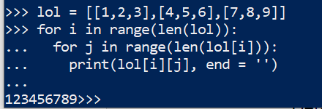
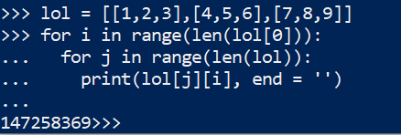
2D Traversal
Traversing through a 2D data structure (list od lists, 2D array, Pandas DataFrame) typically involves using nested loops
This method of traversal can be thought of as moving through the rows (inner for loop) and columns (outer for loop) of the data structure
You can also move inversely, by columns and then rows, by switching the value following ‘in’ in your for loops
Note: make sure your positions i and j are in the correct order when indexing!

Slide 5
Classes

Slide 6
Magic Methods
methods that you can define in your classes that allow objects to behave like built-in types
invoked by Python under special conditions or when a specific syntax is used
Some examples:
__repr__: short for representation, invoked with print() function call
__add__, __sub__, __mult__, __neg__: define behavior for arithmetic between instances of a class object, invoked with arithmetic operators (+, -, *, etc.…)
__eq__, __lt__, __gt__ : define behavior for comparison between instances of a class object, invoked with relational operators (==, <, >, etc.….)

Slide 7
Magic Methods
Operator overloading
use operator overloading on Python magic methods to overwrite how the operations work
This allows you to extend arithmetic (**, *, /, +, -, \) and relational (<, <=, >, >=) operators as well as some built-in functions to work on instances of the class you define
Decorators
a function that wraps over another function in order to modify the behavior of the function without actually modifying the code in the function itself
In Python, the operator for declaring a decorator is ‘@’

Slide 8
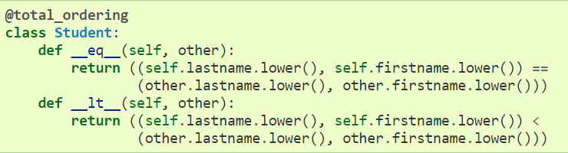
@functools.total_ordering
Used when defining comparison operators for a new class
Given a class where one or more rich comparison operator methods are defined, this class decorator supplies the rest of the comparison operators
The class must define one of __lt__(), __le__(), __gt__(), or __ge__() as well as an __eq__() method.
Ex:
https://docs.python.org/2/library/functools.html

Slide 9
Regex

Slide 10
Regular Expressions
a pattern describing a certain amount of text
We specify a pattern to search for by creating a string, but some of the characters have special meanings that allow them to match multiple other characters
Syntax:
import re #python module for regular expressions is re
text = open(file).read()
p = re.compile(r’<some regular expression>’) #r = raw string!!!
lst = [item[0] for item in p.findall(text)] #findall() to traverse results
Cheatsheet on next slide ->

Slide 11
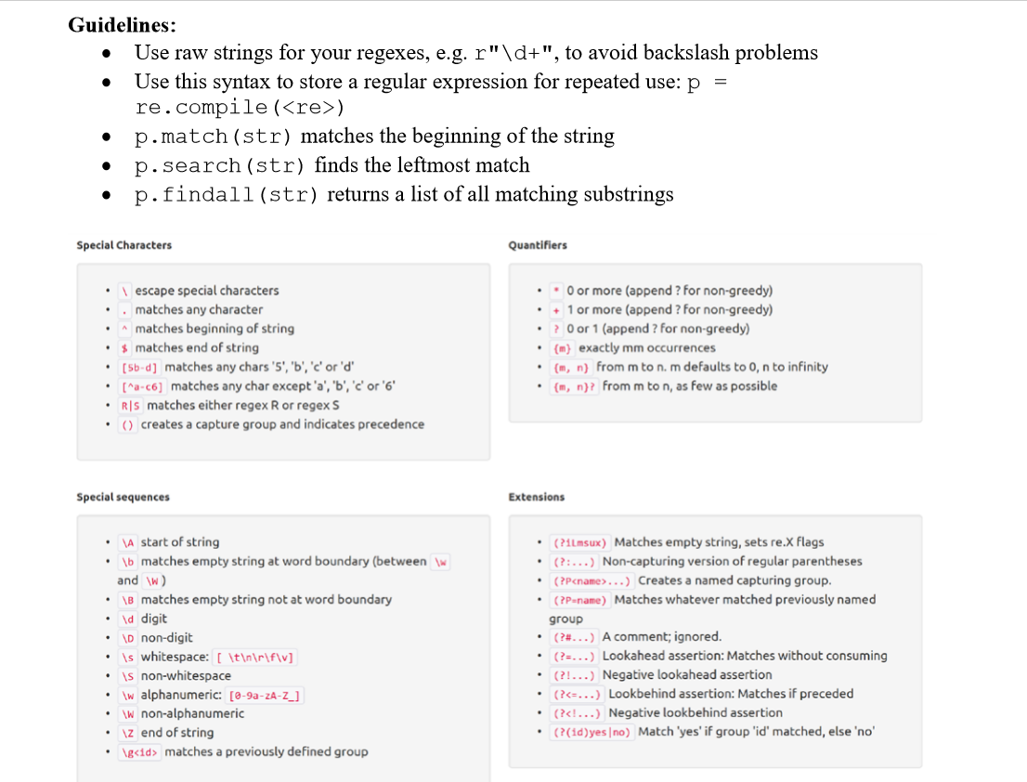

Slide 12
Big O

Slide 13
Big O
Runtime: the amount of time required for an algorithm to run
n: the length of the input for an algorithm
Big O: an estimate of how the runtime changes as n changes
To find the Big-O of a function based on the size of the problem, f(n), we find the term that grows the fastest as n gets really large. We throw away any coefficients
Ex: f(n) = 8n + 2n² + 12 = O(?)
f(n) = O(n²)

Slide 14
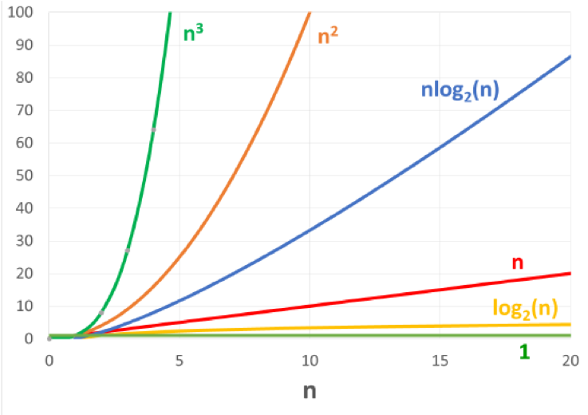
Big O
Big-O list (from smallest to largest):
O(1) - constant time
O(log n) - logarithmic time
O(n) - linear time
O(n log n) - log-linear time
O(n²) - quadratic time
O(n³) - cubic time
Algorithms with these runtimes are called “polynomial time” algorithms.

Slide 15
Big O
Keep in mind that each method and function has their own runtime associated with them
This means that calling methods and functions within a method or function affects the runtime of that code.
Some important runtimes to remember are:
lst.pop(0) – O(n)
lst.pop() – O(1)
lst.insert(0) – O(n)
lst.append() – O(1) usually, O(n) if backend array is full

Slide 16
Memory Diagrams

Slide 17
Memory Diagrams
Computer memory is a sequence of locations, each of which can store data
Each memory location has an ‘address’, i.e. a number that the computer can use to find the location
Interpreted languages – such as Python - must keep track of variable names and does so in ‘namespaces’
Namespaces map variable names to their associated objects in memory, similar to a Python dictionary

Slide 18
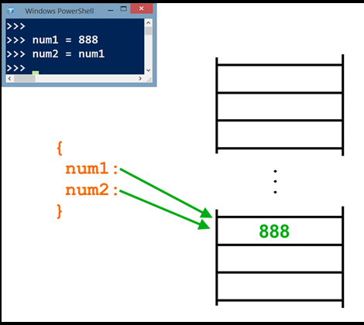
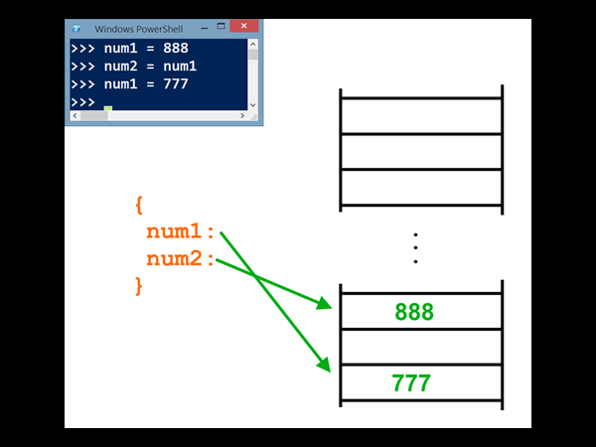

Slide 19
Memory Diagrms

Slide 20
Memory Diagrams
Since immutable objects can’t be changed, you can never affect a variable containing an immutable object by changing a different variable (this includes ints, strings, floats, None, Booleans, and tuples)
However, if you have two variables pointing at the same mutable object and you change it in place, you change both of the variables (because they hold the same object) (But assignment to a variable always creates a new pointer, breaking its old connections)
Parameters are variables that are ‘declared’, but not yet assigned – when an argument is passed into a function, the parameter then points at the same thing the argument does

Slide 21
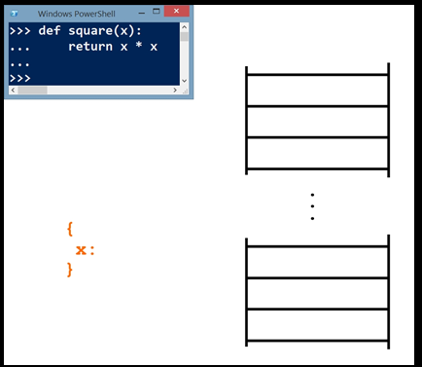
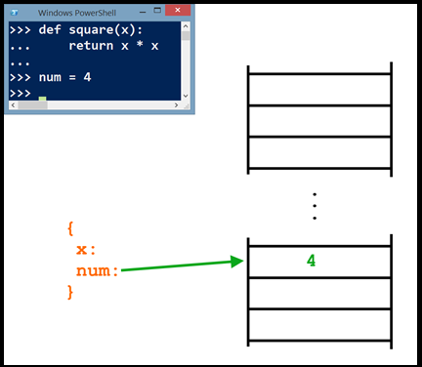
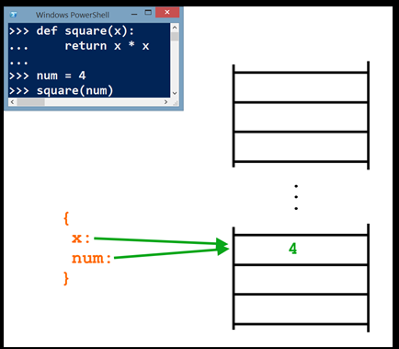
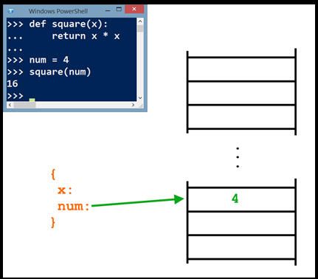
1
Before entering the function
Function is made
2
Before entering the function
Variable ‘num’ is made
3
Upon entering the function
‘num’ is passed in for ‘x’
4
After exiting the function
Immutable ‘num’ is still 4

Slide 22
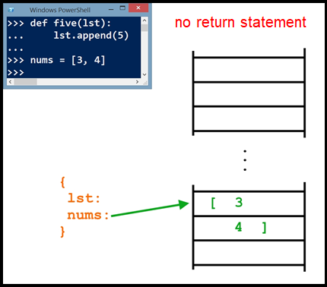
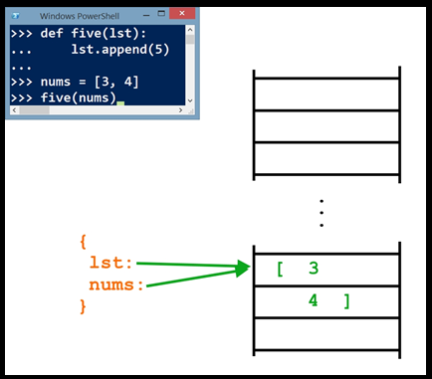
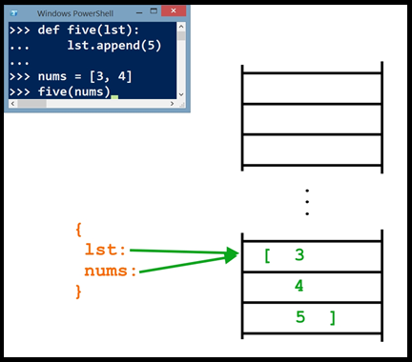
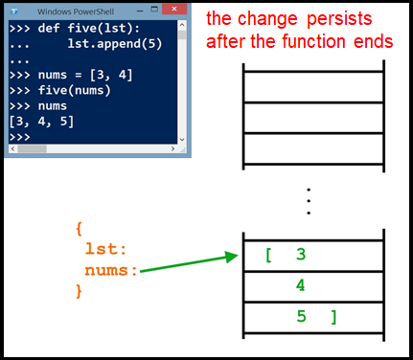
1
Before entering the function
Function & variable ‘nums’ are made
2
Upon entering the function
‘nums’ is passed in for ‘lst’
3
Just before exiting the function
5 is appended to ‘lst’ – same object as ‘nums’
4
After exiting the function
Changes made to ‘lst’ persist in mutable ‘nums’

Slide 23
Binary

Slide 24
Binary
Adding binary numbers
From right to left, add the ones and zeros with this math:
0 + 0 = 0, 0 + 1 = 1, 1 + 1 = 0 carry 1, 1 + 1 + 1 = 1 carry 1
Negation/Two’s Complement
To change the sign of a binary number, switch all the zeros to ones and ones to zeros, then add binary 1
Binary numbers are identified as negative if they begin with 1, and positive if they begin with 0

Slide 25
Binary
Binary to decimal
To convert a binary number to a regular integer, use this formula (8 bit example):
i*2^7 + i*2^6 + i*2^5 + i*2^4 + i*2^3 + i*2^2 + i*2^1 + i*2^0
Where i is a zero or one in the binary number
For negative numbers, either use two’s complement on the number before converting and negate the result, or use this formula (8 bit example):
-i*2^7 + i*2^6 + i*2^5 + i*2^4 + i*2^3 + i*2^2 + i*2^1 + i*2^0 #first term is negative

Slide 26
Linked Data Structures

Slide 27
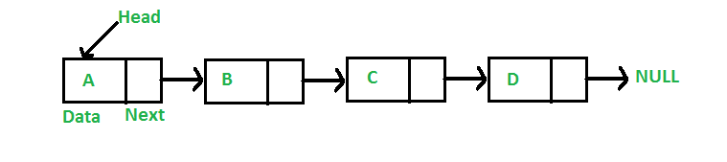
Linked Lists
Each data element (node) contains data and a connection to another data element in the form of a pointer.
Head is the first element in your linked list.
The linked list ends when next == None.

Slide 28
Parse Trees
Also a composed of nodes, with at least one link pointing into each node (except the root) and zero to many link pointing out of each node
Root: only node without incoming edges
Child: a node that is linked out from another node
Parent: a node that is linked down to another node
Leaf: a node with no children
Siblings: nodes that share a parent node

Slide 29
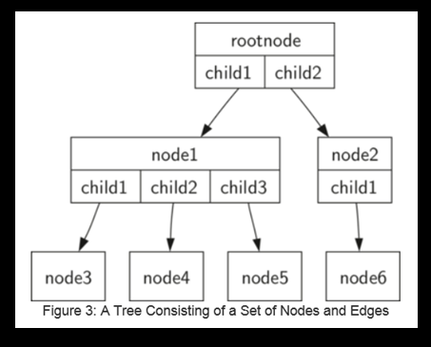
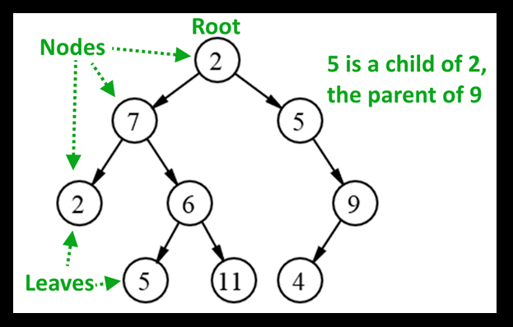
Parse tree where root & nodes have 0-2 children (binary tree)
Parse tree where root & nodes have >= 0 children

Slide 30
Normal Distribution

Slide 31
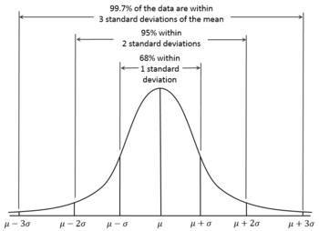
Normal Distribution
Also referred to as the ‘Bell Curve’
Data that is normally distributed is symmetric about the mean and has the highest probability density
This data is also distributed by the 68-95-99.7 rule, where 68% of the data is within +- 1 standard deviation from the mean, 95 within 2, and 99.7 within 3

Slide 32
Exercises
Read through worksheet_final_review.docx and execute the given instructions in python

